Slide 1
About the Lab exercises
1. Work Break-down Structure (Process Based, Product Based, Geographic Based and Role Based)
2. Estimations Cost and Schedule
3. Entity Relationship Diagram, Context flow diagram, DFD (Structural Modeling and Functional Modeling)
4. State Transition Diagrams (Behavioral Modeling)
5. System Requirements Specification
6. UML diagrams for OO Design
7. Tools for Version Control
8. Black-box, White-box testing
9. Non-functional testing
PROJECT DEVELOPMENT

Slide 2
Work Break-down Structure WBS (Process Based, Product Based, Geographic Based and Role Based)

Slide 3
Remember!
WBS defines a project and groups the project elements for managing a project.
An organizational chart describes the project team that will accomplish the project.

Slide 4
Preparing a WBS
In preparing a WBS there are a number of steps that need to be taken to make sure the WBS developed will help manage your project. Below and on the following pages we will discuss these steps.
Identify final project products necessary for achieving project success. The WBS should assist the project manager in developing a clear vision of the end product. You need to answer the following question:
What must be delivered to achieve project success?
You may need to review the project scope documents for guidance.

Slide 5
Identify the major deliverables necessary for project success.
These are items that by themselves do not satisfy the project need but combined make up a successful project
Examples: a design completion, generator delivery, or acceptance test completion

Slide 6
Preparing a WBS
Incorporate additional levels of detail until management requirements for managing and controlling the project are met.
Remember that each project is different, thus each WBS will be different
WBS’s from previous projects can be used as templates, but remember that the management philosophy and the level of details may be different from project to project
Understand your controlling and reporting requirements
Projects have different requirements; make sure you take these into consideration when developing low level details

Slide 7
Review and refine the WBS until the stakeholders agree with
the level of project planning and reporting.
Remember that no matter how detailed a WBS is, there are planning and reporting restrictions a WBS creates

Slide 8
Preparing a WBS
In developing a WBS, one must realize that there are multiple ways to develop a WBS for any given project. Some ways might be better than others, but the two most important item to remember are that the WBS must contain all approved scope and the Project Manager must develop the WBS to reflect the way he/she intends to manage the project.
Other items to consider when developing a WBS are:
Reporting requirements
Size of project
Resource executing the work (contractors vs. in-house)
Complexity of the project
Notes:
Same graphic from previous page.

Slide 9
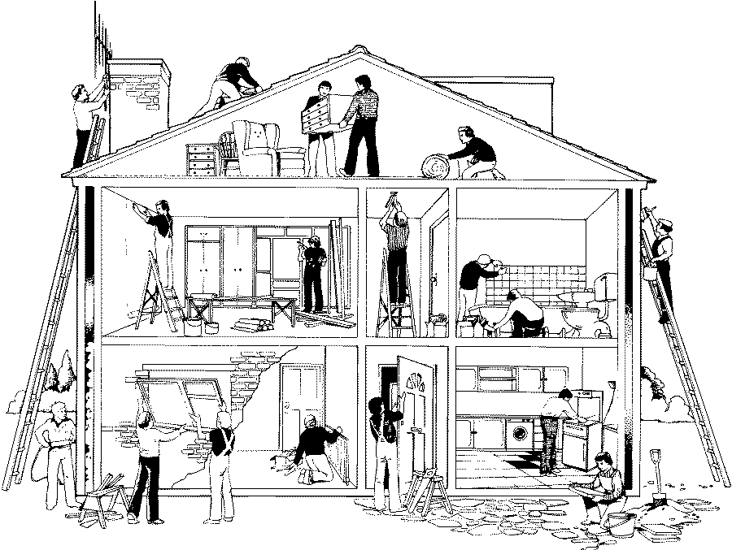
Building a WBS
Armed with the basics of the WBS, it is time to examine them in more detail and to begin to understand how to build one. To do this, let’s look at building a WBS for the construction of a single family home. First, take a moment to familiarize yourself with some background information about the construction company, which appears on the next page.
Notes:
Picture of people building a house.

Slide 10
WBS: Structure
The ACME Housing Corporation, which you own, has been contracted to build its first house. You want to be able to manage your projects effectively and efficiently, so you charge your project managers to develop an appropriate WBS. You decide to manage the project by the individual tasks necessary to complete the house.
You hope that this is the first of many houses that ACME will build, so you start the WBS with ACME in the highest position, or Level 1. Accordingly, Level 1 is given a WBS code of 1. You assign the WBS code of 1 to the highest level because all future projects (houses) will be summarized at Level 1.
NOTE: For ease of explanation, our example will assume the following:
Design is complete
All permits issued
All Material ordered
Inspection happens
Level 1 →
Notes:
Picture of a house with the name ACME House WBS to the right. There is a box with the ACME Housing Corporation in it with the WBS code number 1. This is relating to the Level 1 of the WBS.

Slide 11
← Level 1
← Level 2
Level 3 →
Level 4 →
Notes:
This graphic builds on the graphic from the previous page. Beneath the Level 3 boxes are Level 4 boxes which represent the task for this project. The Level 4 task are: Under
Concrete, Pour Foundation 1.1.1.1, Install Patio 1.1.1.2, Pour Stairway 1.1.1.3. Under Framing, Frame Exterior Walls 1.1.2.1, Frame Interior Walls 1.1.2.2, Install Roofing Trusses 1.1.2.3. Under Plumbing, Install Water Lines 1.1.3.1, Install Gas Lines 1.1.3.2, Install B/K Fixtures 1.1.3.3. Under Electrical Install Wiring 1.1.4.1, Install Outlets/Switches 1.1.4.2, Install Fixtures 1.1.4.3. Under Interior, Install Drywall 1.1.5.1, Install Carpets 1.1.5.2, Painting 1.1.5.3. Under Roofing, Install Felt 1.1.6.1, Install Shingles 1.1.6.2, Install Vents 1.1.6.3.

Slide 12
WBS: Structure
Notes:
Same graphic from the previous page showing the WBS

Slide 13
Work Breakdown Structure (WBS) Tree
1 ACME Housing Corporation
1.1 New Home Construction
1.1.1 Concrete
1.1.1.1 Pour Foundation
1.1.1.2 Install Patio
1.1.1.3 Pour Stairway
1.1.2 Framing
1.1.2.1 Frame Exterior Walls
1.1.2.2 Frame Interior Walls
1.1.2.3 Install Roofing Trusses
1.1.3 Plumbing
1.1.3.1 Install Water Lines
1.1.3.2 Install Gas Lines
1.1.3.3 Install B/K Fixtures
1.1.4 Electrical
1.1.4.1 Install Wiring
1.1.4.2 Install Outlets/Switches
1.1.4.3 Install Fixtures
1.1.5 Interior
1.1.5.1 Install Drywall
1.1.5.2 Install Carpets
1.1.5.3 Install Painting
1.1.6 Roofing
1.1.6.1 Install Felt
1.1.6.2 Install Shingles
1.1.6.3 Install Vents

Slide 14
How to Create a Work Breakdown Structure? (Step-By-Step)
Step 1: List Every Major Deliverable
Step 2: Break Each Deliverable Into Smaller Work Components
Step 3: Split Each Work Component Into Work Packages
Step 4: Identify The Dependencies
Step 5: Time to Prioritize and Assign

Slide 15
Do’s and Don’ts in WBS
Use Nouns, Not Verbs
Ask For Feedback
Follow the 100% Rule
Keep All Elements Mutually Exclusive

Slide 16
Tools Used
Edrawmax
Lucidchart
SmartDraw
Mindview
Creately

Slide 17
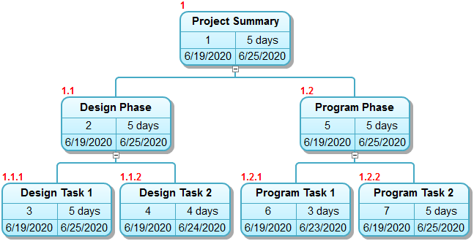
Process / Phase based WB “Schedule”

Slide 18
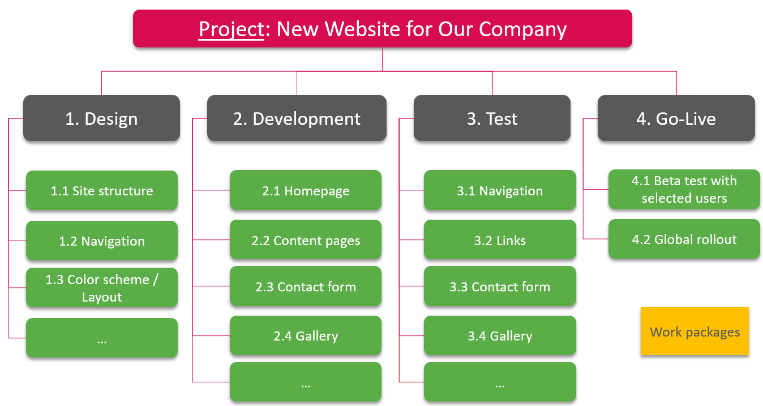

Slide 19
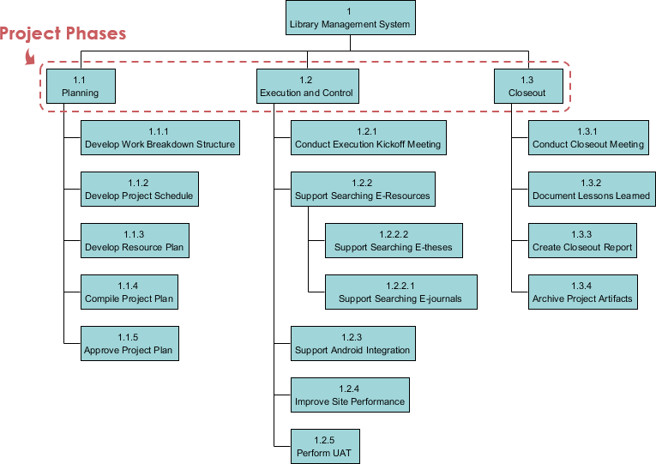

Slide 20
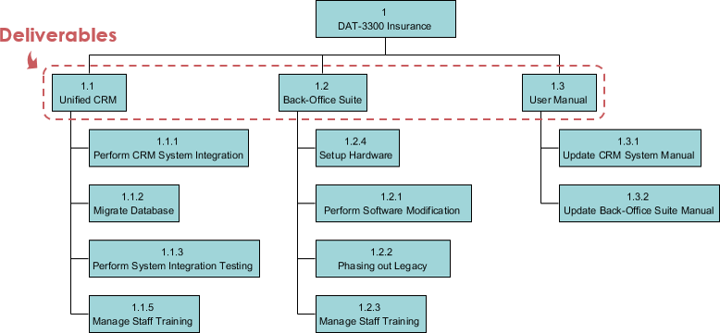
Deliverable / Product based WBS

Slide 21
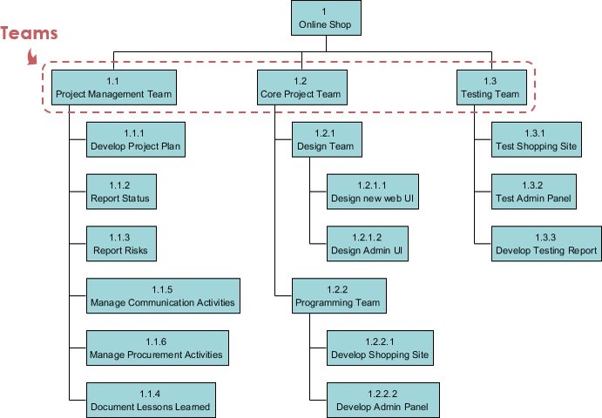
ROLE BASED WBS

Slide 22
WBS vs Project Schedule
A work breakdown structure clarifies the scope and provides you with the “what” of the project. You will know exactly what you need to complete to finish the project.
On the other hand, the project schedule will provide you with detailed activities you need to complete the project. You can see the duration of all activities, milestones, critical path, etc.
WBS is the basis of the project schedule as it provides work packages. These work packages contain project activities, resources, duration, and relationships.

